Slide 1
Moisture and Humidity measurement..

Slide 2
Moisture content of materials..
The amount of free moisture (water) present in any material depends upon it’s chemical and physical properties.
In the measurement of moisture content in materials, water must be considered to be present in all three distinct phases(free or surplus moisture, physically bound moisture, chemically combined hydrogen and oxygen).

Slide 3
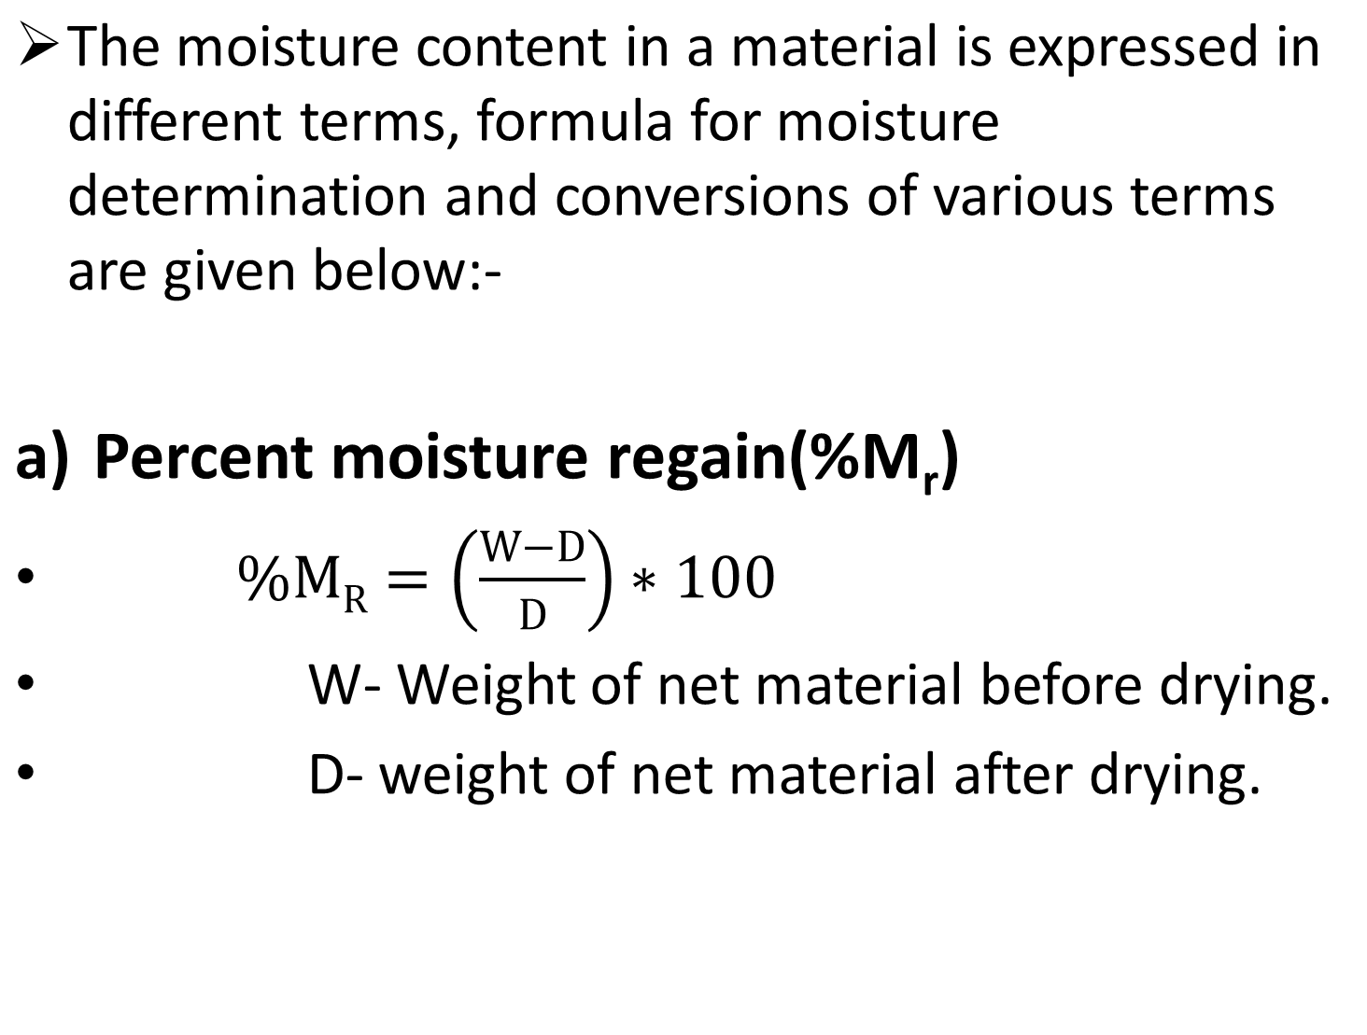

Slide 4
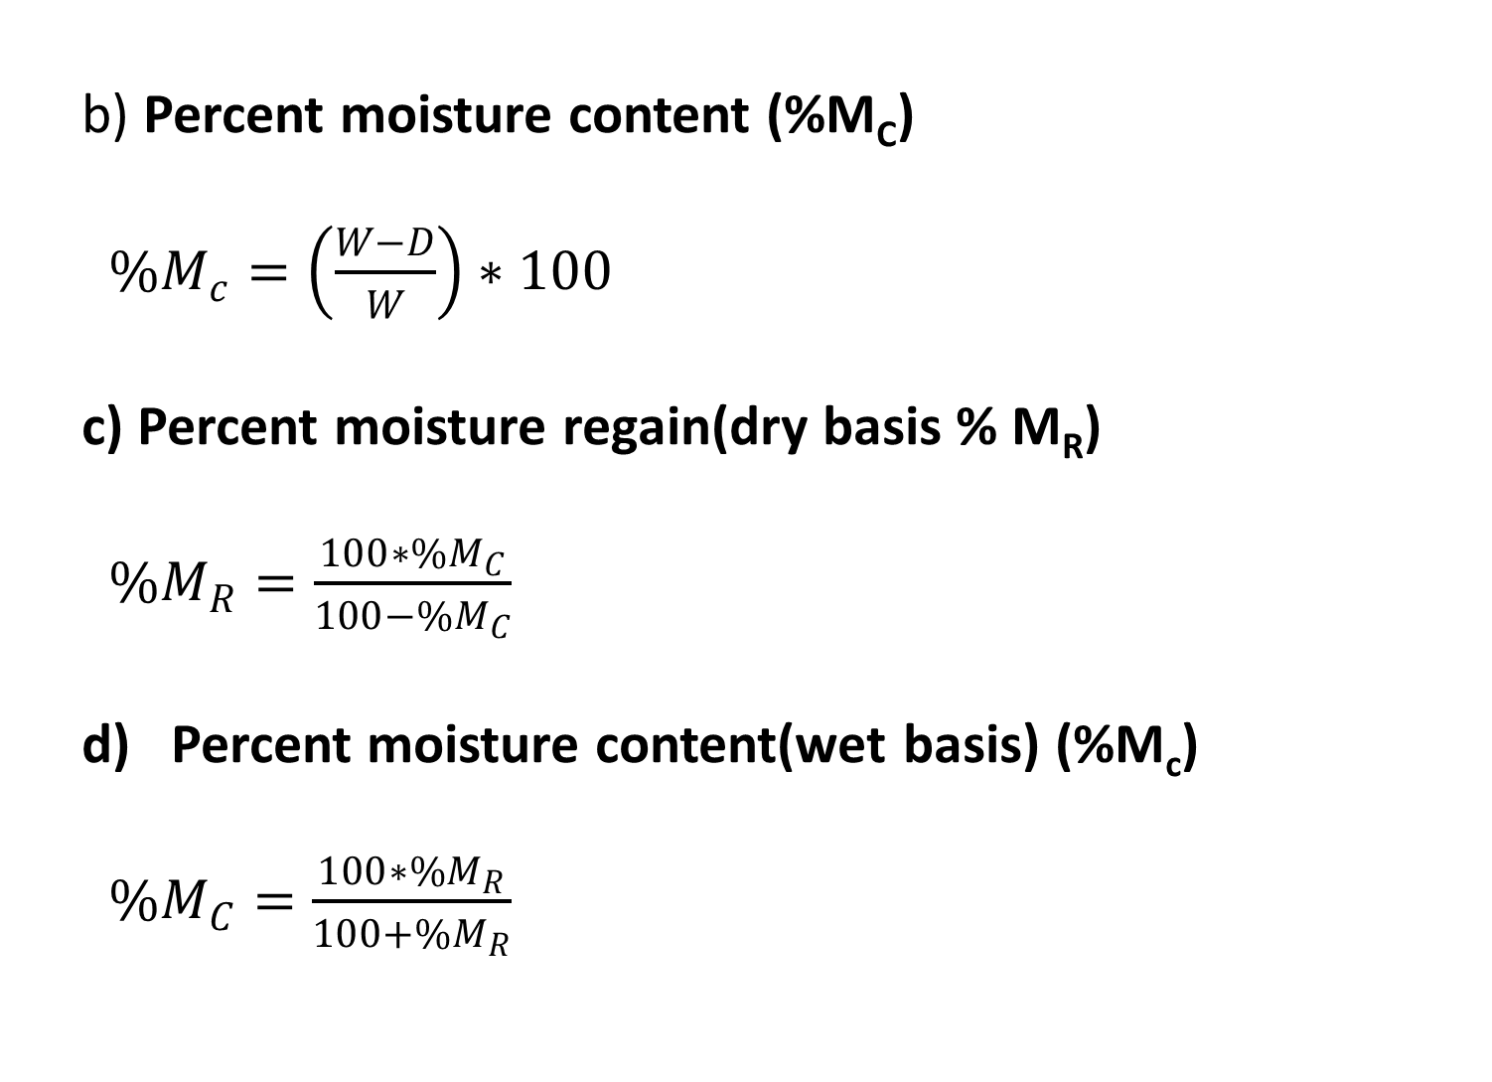

Slide 5
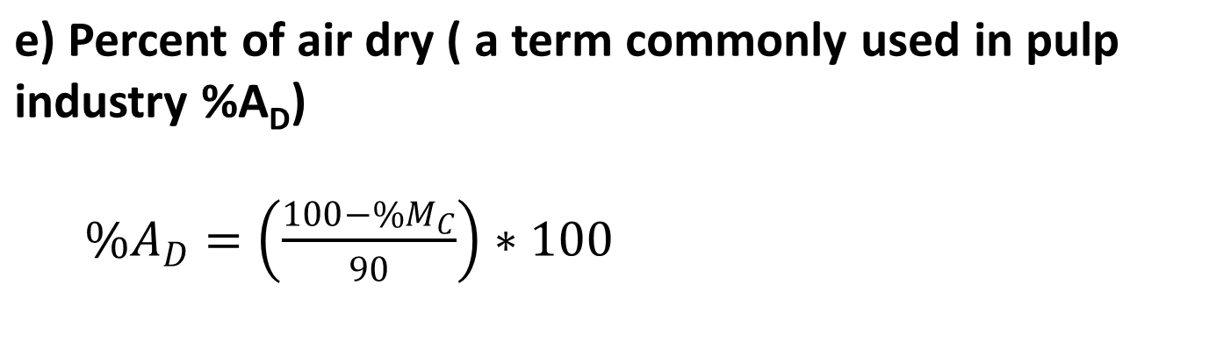
Methods of measurements:-
Factors which depends for measurement of a moisture (free water) such as :-
1) Availability of equipment
2) Type of the product
3) Speed required
4) Accuracy

Slide 6
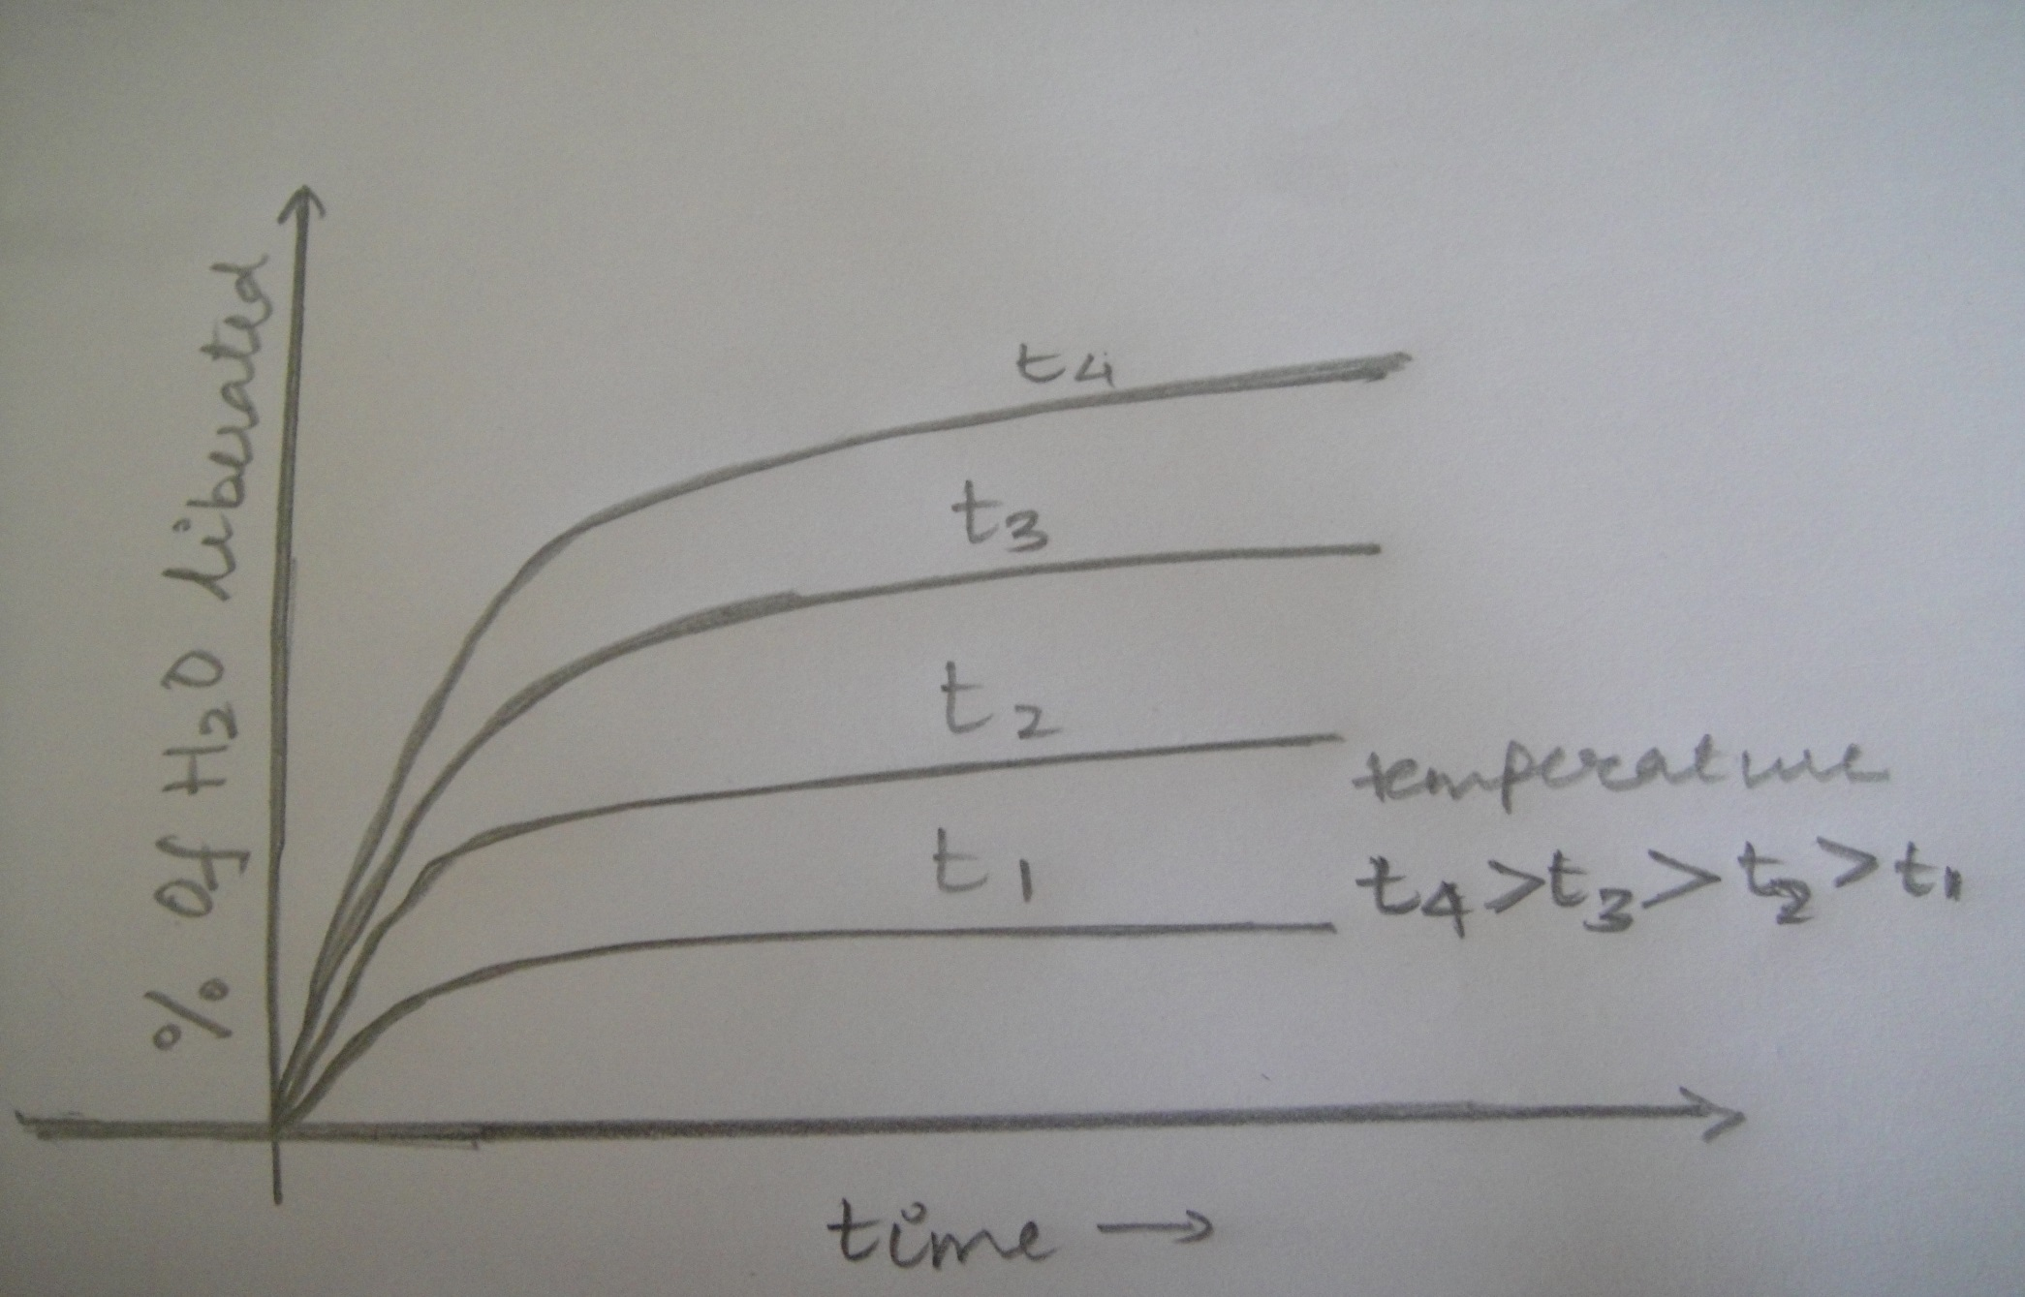
Example: thermal (oven) drying method.

Slide 7
This method is the simplest and commonly used method to determine the moisture content.
This method can be applied to solids, liquids, fibrous, granular materials.
When heat is applied to a moisture material water gets volatilized so long as the vapor pressure of the water in the material is greater than that of the surrounding air.
Water is liberated rapidly at first and gradually slows down until no more can be liberated without rising the temperature.

Slide 8
If a curve is plotted between the time of drying and the percentage of water liberated for various constant temperatures it will be observed that curve reaches a flattest portion towards the end and the time-temperature in heating process should be selected corresponding to this temperature.
After the time and temperature have been selected all the samples must be tested at these level.

Slide 9
Advantages:
Method is rapid.
Does not require operators.
Initial investment and running costs are minimum.
Method is not limited to either micro or macro samples.
Limitations:
Does not give a very accurate result.
It cannot differentiate between water and other volatile materials.

Slide 10
Thank you..

